Slide 1
Select, Answer and Explain: Interpretable Multi-hop Reading Comprehension over Multiple Documents
김주찬

Slide 2
Purpose of this paper
Propose an effective and interpretable Select, Answer and Explain(SAE) system to solve the multi-doc RC problem.

Slide 3
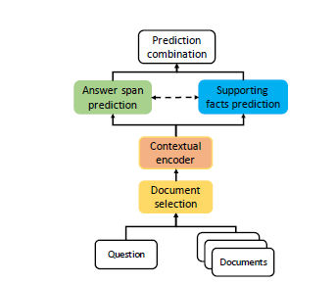
Select, Answer and Explain
Designed a document selection module to filter out answer-unrelated documents and remove distracting information
‘Answer and explain’ model is trained in a multi-task learning way to jointly predict answer and supporting sentences on gold docs.
Contextual sentence embedding is summarized over token representations based on mixed attentive pooling mechanism

Slide 4


Select gold docs
For every document, generate an input to feed through BERT by concatenating “[CLS]” + question + “[SEP]” + document + “[SEP]”
Use the “[CLS]” token output from BERT as a summary vector for each question/document pair.
Lastly, using this summarized vec, project it to 1-d and calculate binary Cross Entropy loss
Notes:
ti is the label of Di
n is the number of documents
P(Di) is the probability of document i being in label ti.
하지만 이는 각 doc을 분리해서 고려하기 때문에,

Slide 5
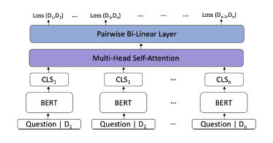


Select gold docs
MHSA
to encourage inter-document interactions
Pairwise Bi-Linear Layer
to better distinguish a small set of gold documents from the rest distracting documents
Notes:
Q, K, and V are linear projections from “CLS” embeddings
of documents, representing attention queries, key
and values

Slide 6
Answer and Explain
Answer Prediction
Supporting sentence prediction

Slide 7

Answer Prediction
2-layer Multilayer Perceptron (MLP) with output size 2 is applied to the BERT output Hi
output is used for start position prediction, and the other for end position prediction,
We calculate the cross entropy between logits of all possible indices from 1 to L, and the true start and end position of answer span.
Notes:
first row of ^Y
is the logits of start position and
second row is the logits of end position.
ystart and yend are
the labels of start and end positions in the range [0, L-1].
CE denotes cross entropy loss function.

Slide 8


Supporting Sentence Prediction
Attention-based summarized sentence representation to introduce complementary information from answer prediction.
Notes:
where Sj is the matrix representing the token embeddings
within sentence j (for clarity, we drop the sample index i
here); js and je defines the start and end positions, and Lj
is the length of sentence j.
Attention의 가중치의 계산은 attentio의 한 부분은 Sj의 self attention에서 계산되고, 다른 부분은 start와 end position의 logit의 합으로 계산되는 방식이라고 합니다.
where fatt is a two-layer MLP with output size 1, and
function is the softmax function applied on the sequence
length dimension. j 2 RLj1 denotes the attention weight
on each token of sentence j.

Slide 9
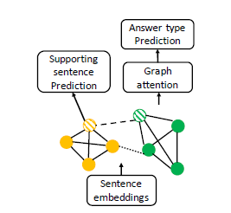
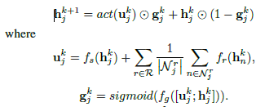
Suporting Sentence Prediction
GNN model over sentence embeddings sj to explicitly facilitate multi-hop reasoning over all sentences from the predicted gold documents
For Message Passing, we use multi-relational GCN with gating mechanism
Notes:
Add an edge between two nodes if they are originally
from the same document (solid line in Figure 4).
2. Add an edge between two nodes from different documents
if the sentences representing the two nodes both
have named entities or noun phrases (can be different) in
the question (dashed line in Figure 4).
3. Add an edge between two nodes from different documents
if the sentences representing the two nodes have the same
named entities or noun phrases (dotted line in Figure 4).
first type of edge is that we want
the GNN to grasp the global information presented within
each document.
Thus, we design the
second and third types of edge to better capture such cross document
reasoning path.
----
graph nodes and reasoning is achieved
by conducting message passing over nodes with contextual
information.
Assume h0j
represents initial node embedding
from sentence embedding sj , the calculation of node
embedding after one hop (or layer) can be formulated as
R is the set of all edge types, Nrj is the neighbors of node j
with edge type r
and hkn is the node representation of noden in layer k.
| | indicates the size of the neighboring set
Each of fr, fs, fg defines a transform on the input node
representations, and can be implemented with a MLP.
Gate
control gk
j , which is a vector consisting of values between
0 and 1, is to control the amount information from computed
update ukj
or from the original node representation
hkj
. Function act denotes a non-linear activation function.

Slide 10

Supporting Sentence Prediction
After message passing on the graph with predefined number of hops, each node has its final representation hj .
The final training loss is the summation of span prediction, support sentence prediction and answer type prediction losses
Notes:
where BCE() represents binary cross entropy loss function;
ysp and yans are the labels of support sentences and answer
types respectively.We add a weight to span loss to account
for the scale difference of different losses.

Slide 11
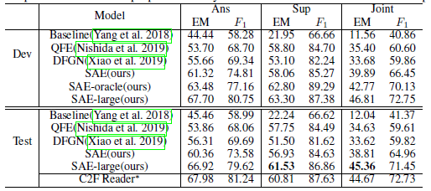

Result
SAE (Bert-base) and SAE-large(Roberta) showed better result than Baseline
Adding MHSA and PR gives better performance
Notes:
Ablation study results on HotpotQA dev set.
PR(0,1) stands for giving 0 score to non-gold documents
and 1 score to all gold documents when preparing pairwise
labels, and PR(0,1,2) stands for giving 2 score to the gold
document with answer span.

